Slide 1
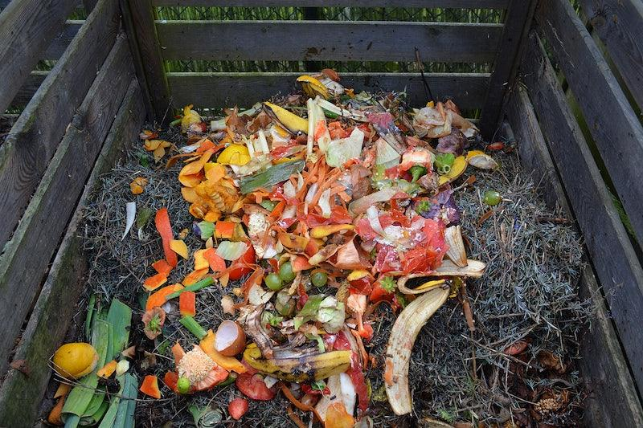
Compost

Slide 2
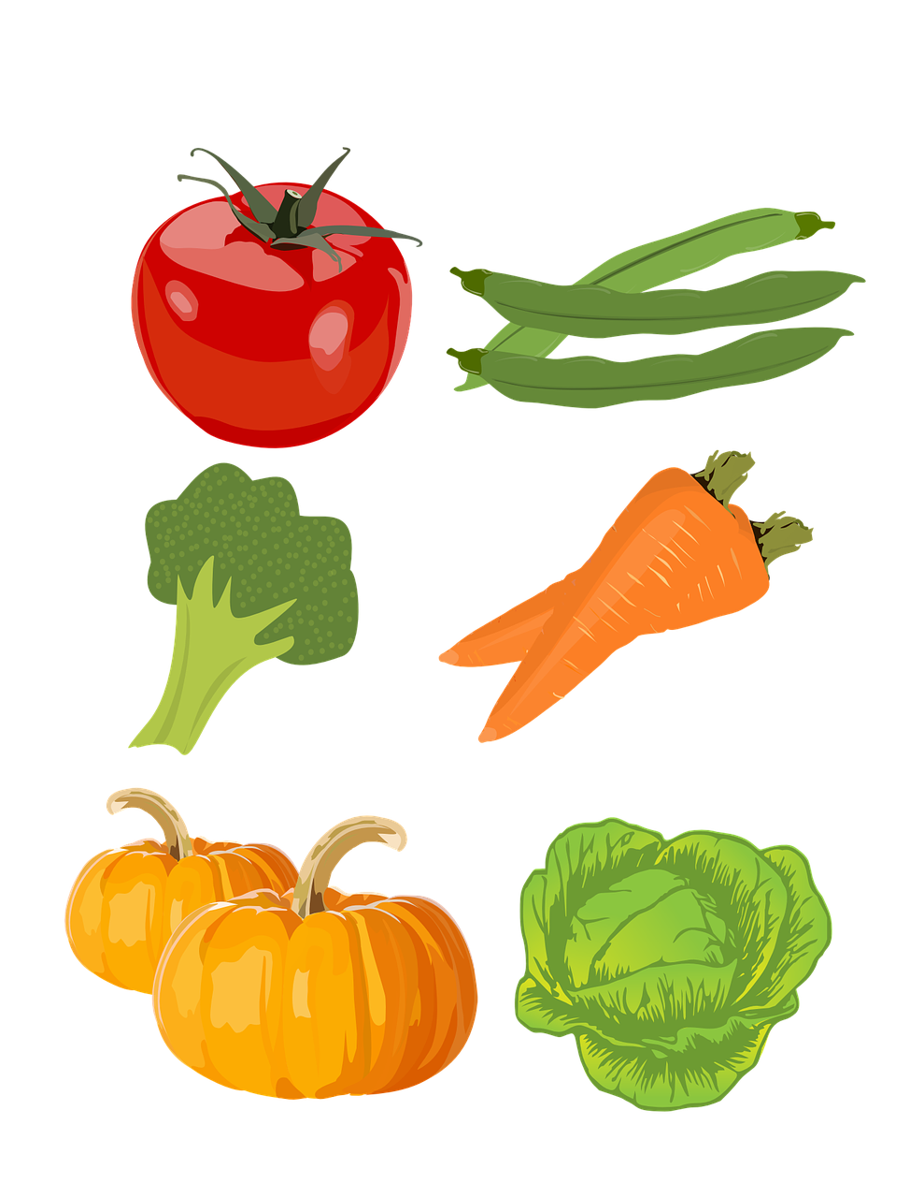
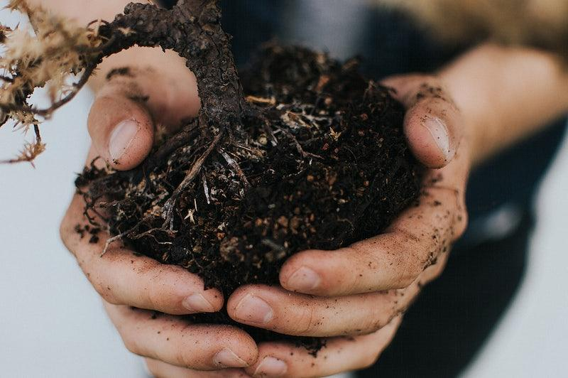
…is magic!

Slide 3

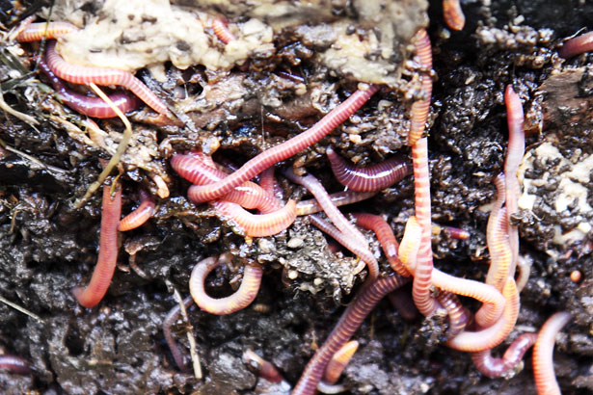
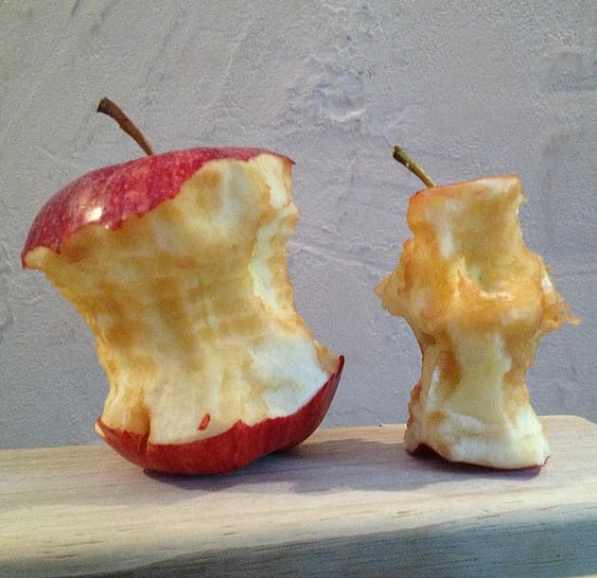
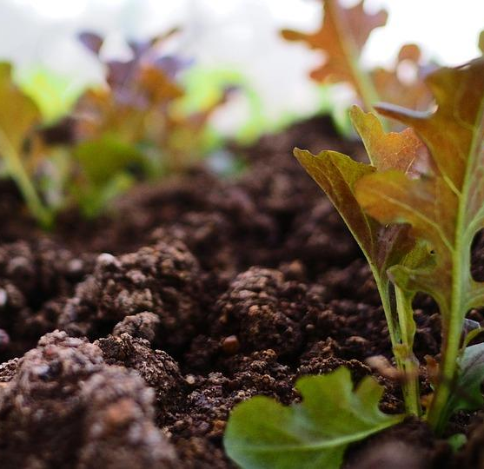
Let’s Talk About:
Composting
Vermicomposting
Food Waste
Soil Health

Slide 4
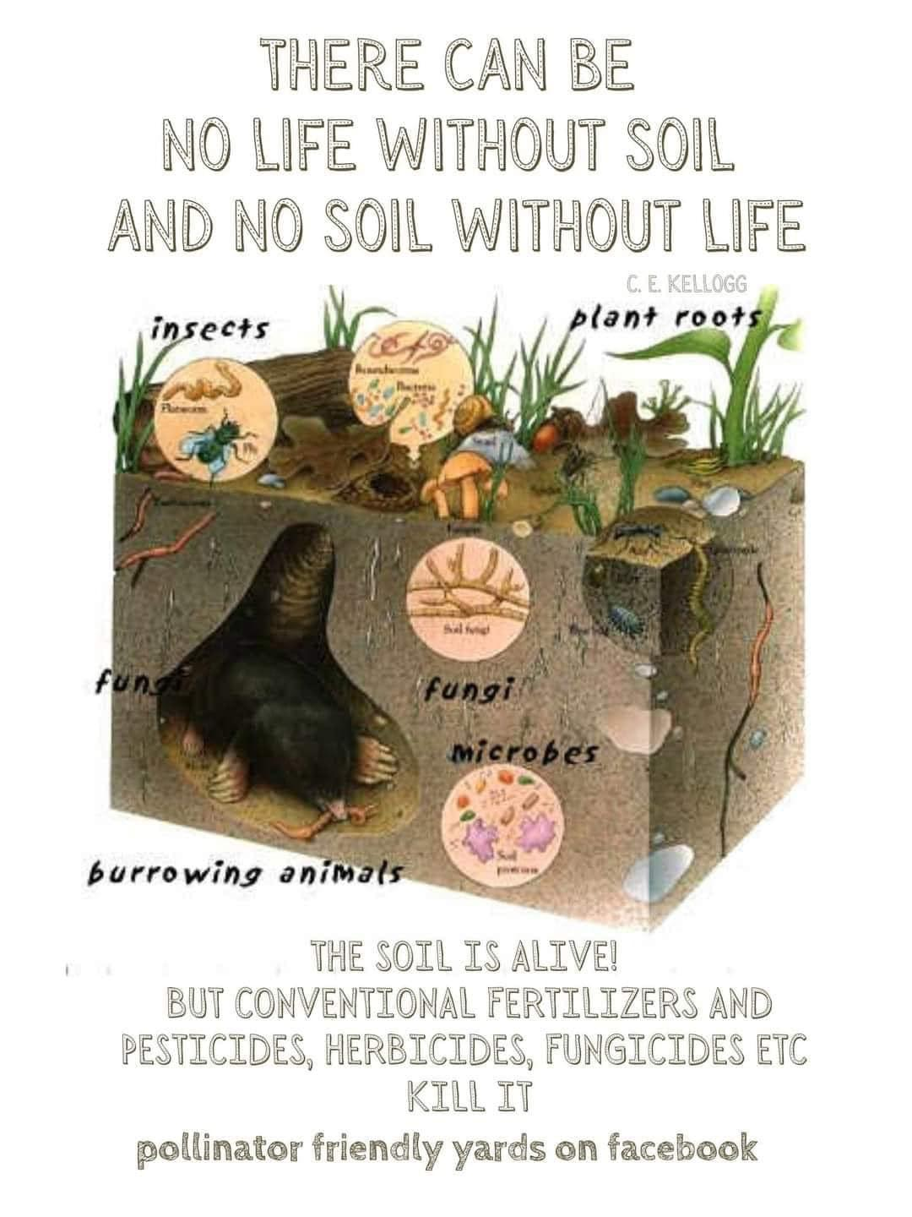
What is composting?
compost (v.)
To recycle natural waste, like food scraps and leaves, to make fertilizer that helps plants grow.

Slide 5

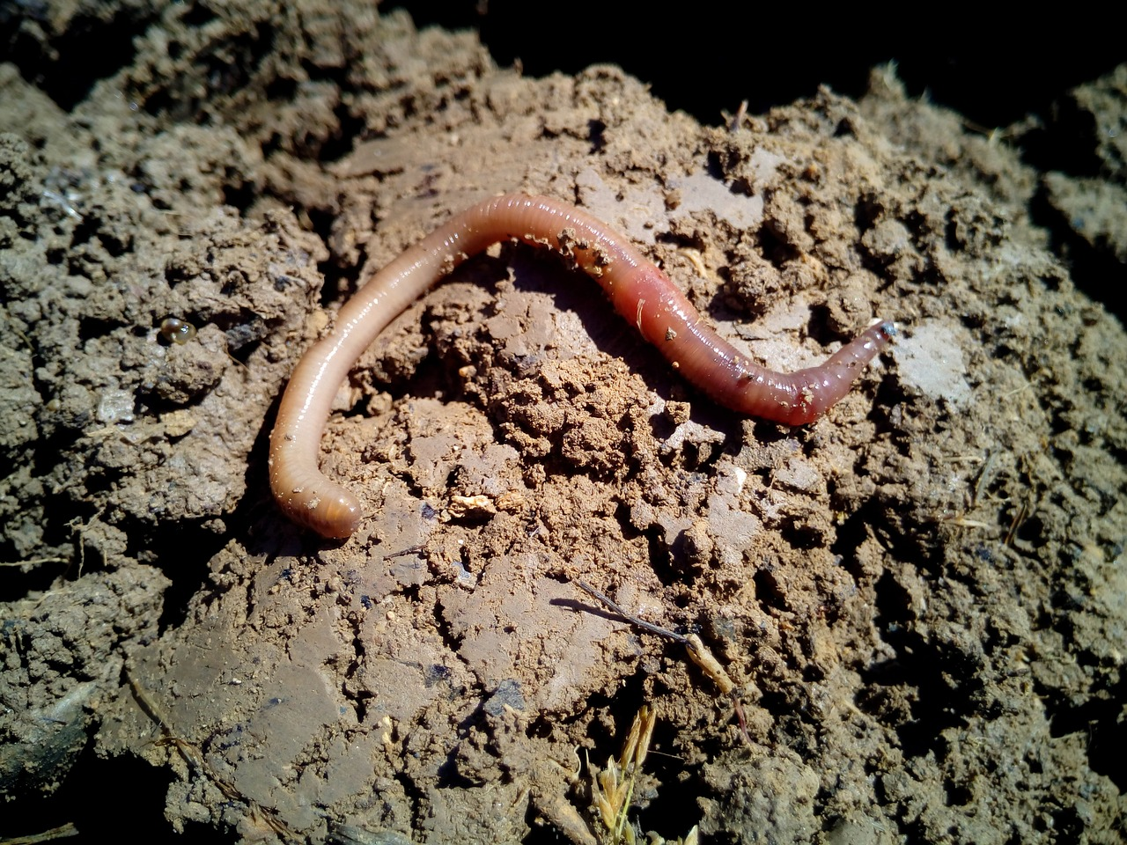
Decomposers help make Compost!
Make the Most of Compost!
5 min. video by SciShow Kids
SciShow Kids
https://www.youtube.com/watch?v=Q5s4n9r-JGU

Slide 6
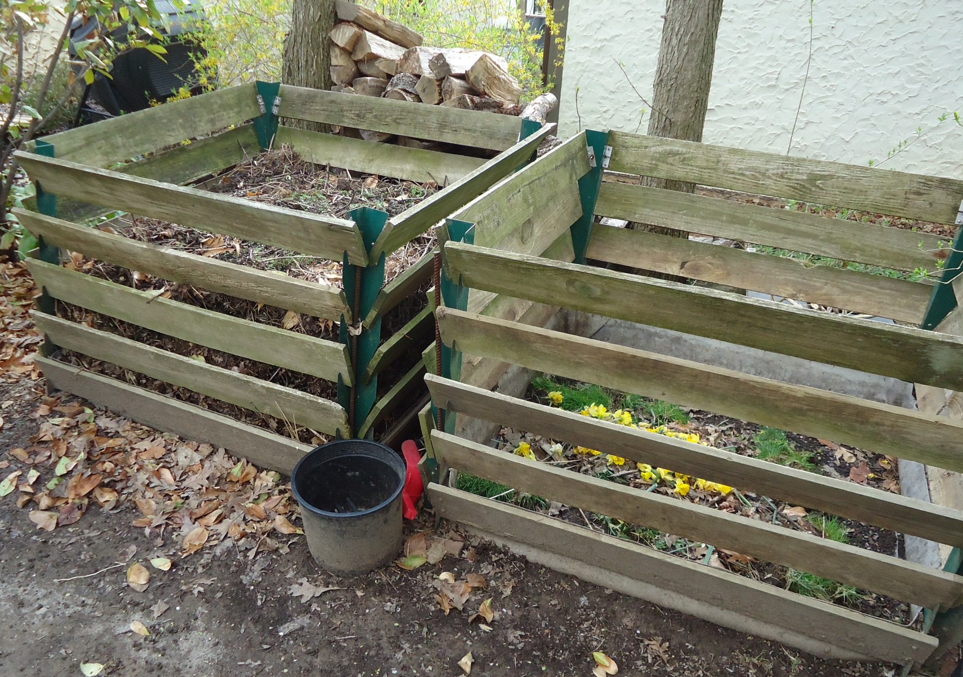

Backyard Composting: Home Video
https://photos.app.goo.gl/PUsFdafwSHhrHrYe6

Slide 7
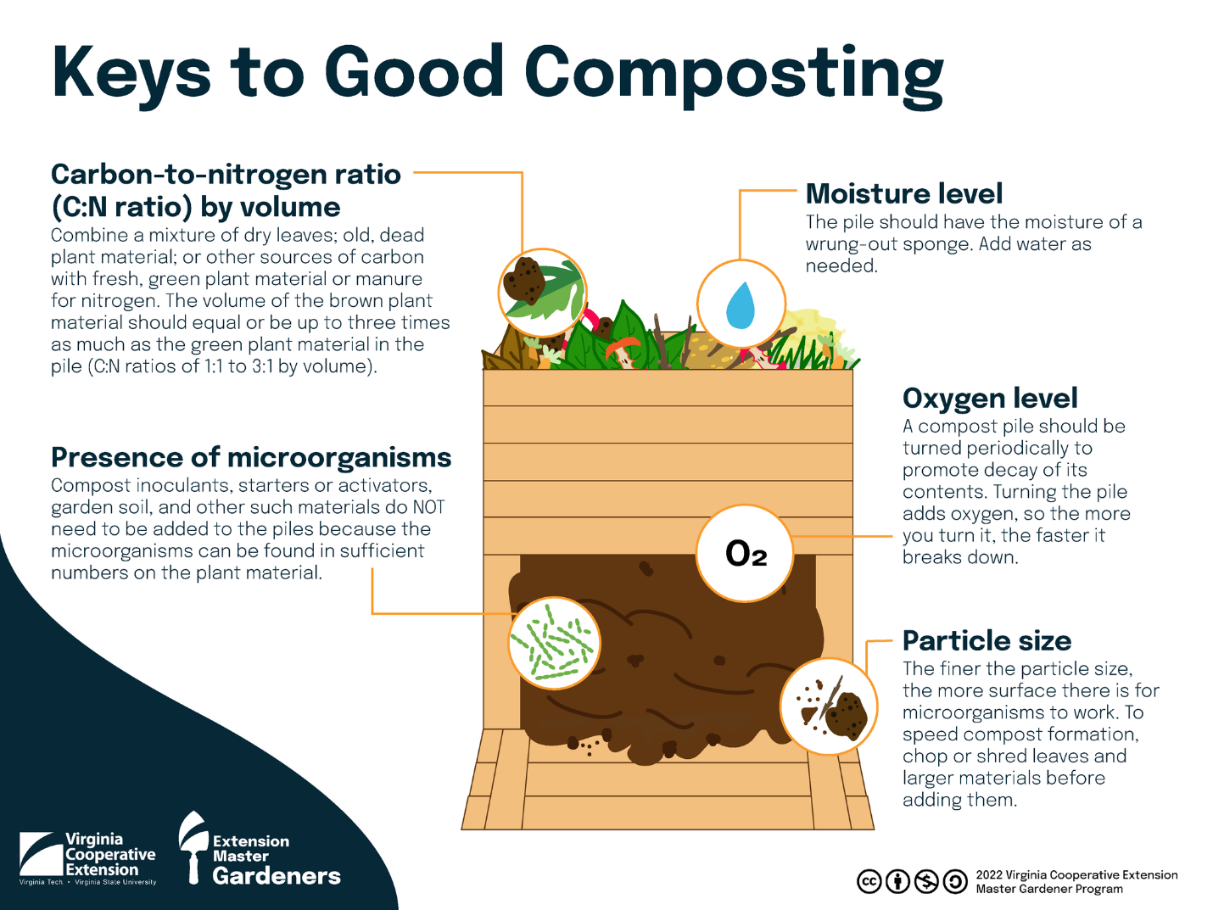

Slide 8
What is Vermicomposting?
Vermicomposting is composting with worms.
The Red Wiggler worms eat food waste such as vegetable and fruit scraps, coffee grounds, and egg shells.
Worms turn the food into soil through their poo!

Slide 9
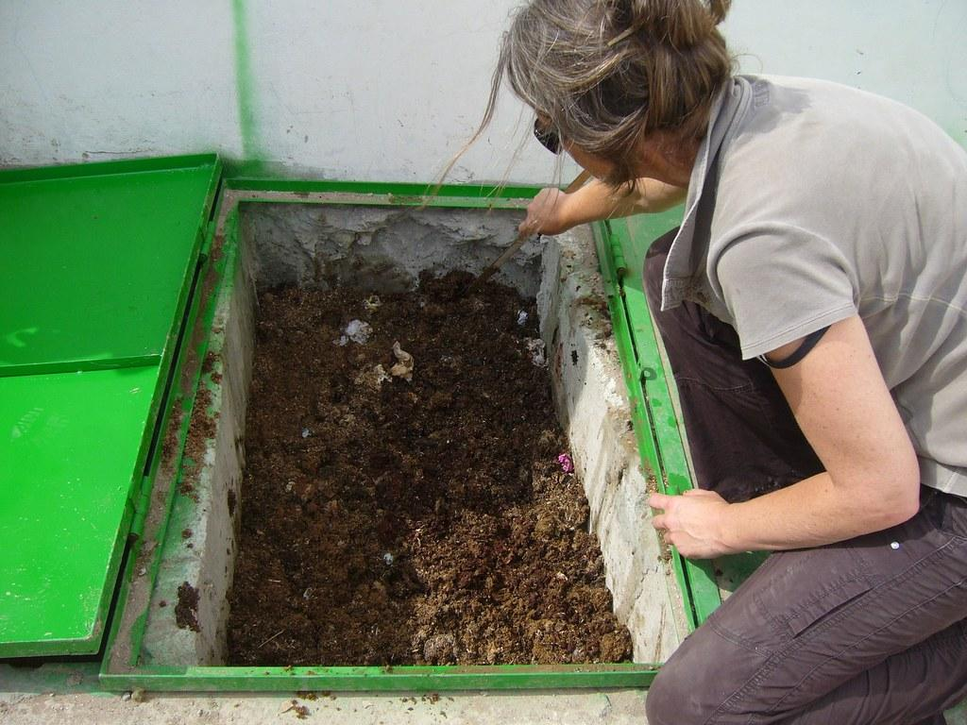
Vermicomposting: Home Video
https://photos.google.com/share/AF1QipO-Qhq73flfiVUMV-gETyEniCjU5KjLaxjiohUN1TDrbyBJ2h7i2nFh-wpbDThgEw/photo/AF1QipPP4kjfFamGP8Q0pHZSCZuMtxByH5S2AUGT25ck?key=MkRiUXZMZE1qUDl1WGFpRGg1SU5HcFJ5TDdHM3pR

Slide 10
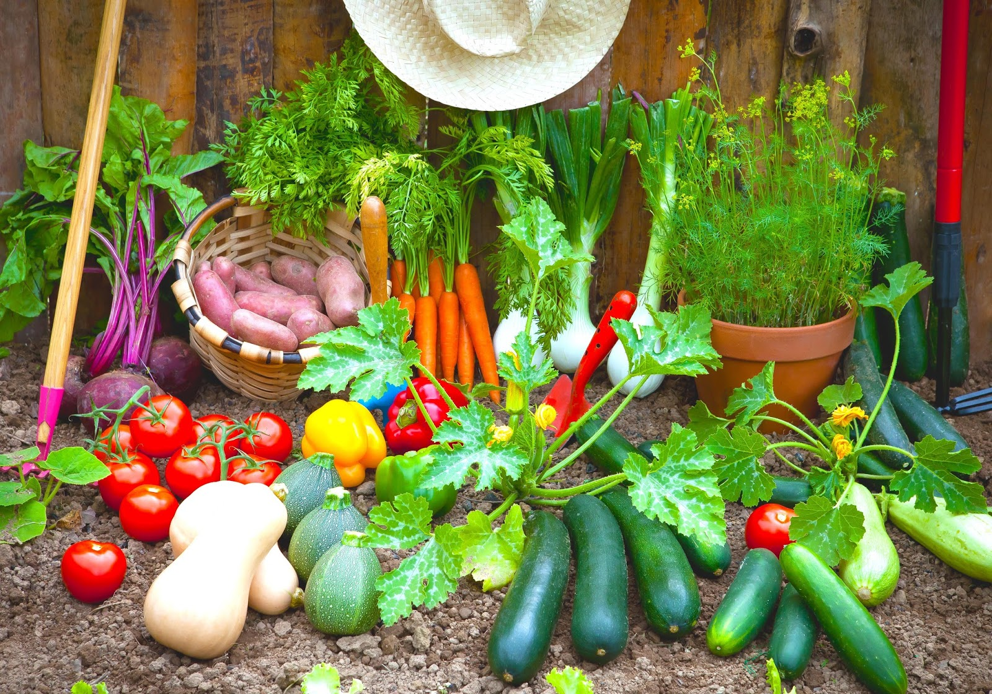
Why is Soil Health Important?
Instead of trashing food scraps, compost them to create NEW soil for your home gardens!
You have the power to transform trash to treasured material:
Healthy soil for growing plants and crops.

Slide 11
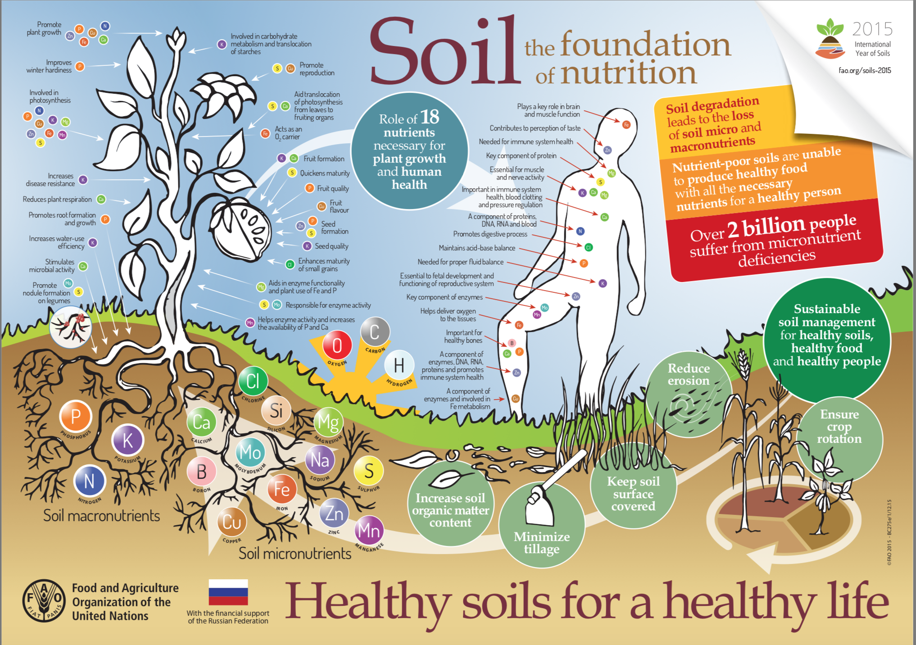

Slide 12

Thank you to the folks who helped create this presentation!
Christina Mehrkens, UWL Environmental Studies alumni
Trey Wellik, videographer & editor
Dr. Jan Wellik, UW-La Crosse Environmental Studies

