Slide 1
Nature Journaling is a…
Dr. Jan Wellik, EdD​
Journey of discovery with nature
Tool for self-reflection and creative expression
Scientific observation for learning
And more!

Slide 2
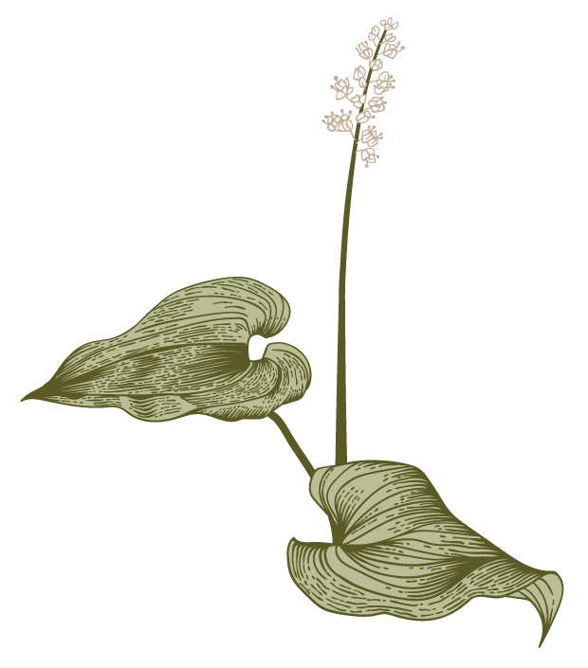
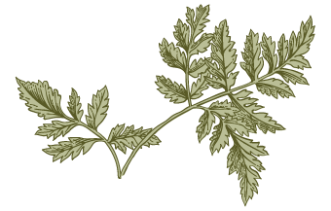
Overview:
E
Eco Expressions
Nature Journaling
Forest Bathing
Nature is Healing

Slide 3
www.EcoExpressions.org Wild Fridays: Nature & Art Play Summer Camps Mindfulness Club Nature Journaling workshops & retreats for adults
Eco Expressions, LLC

Slide 4
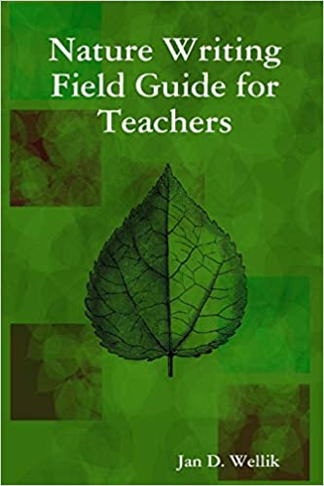
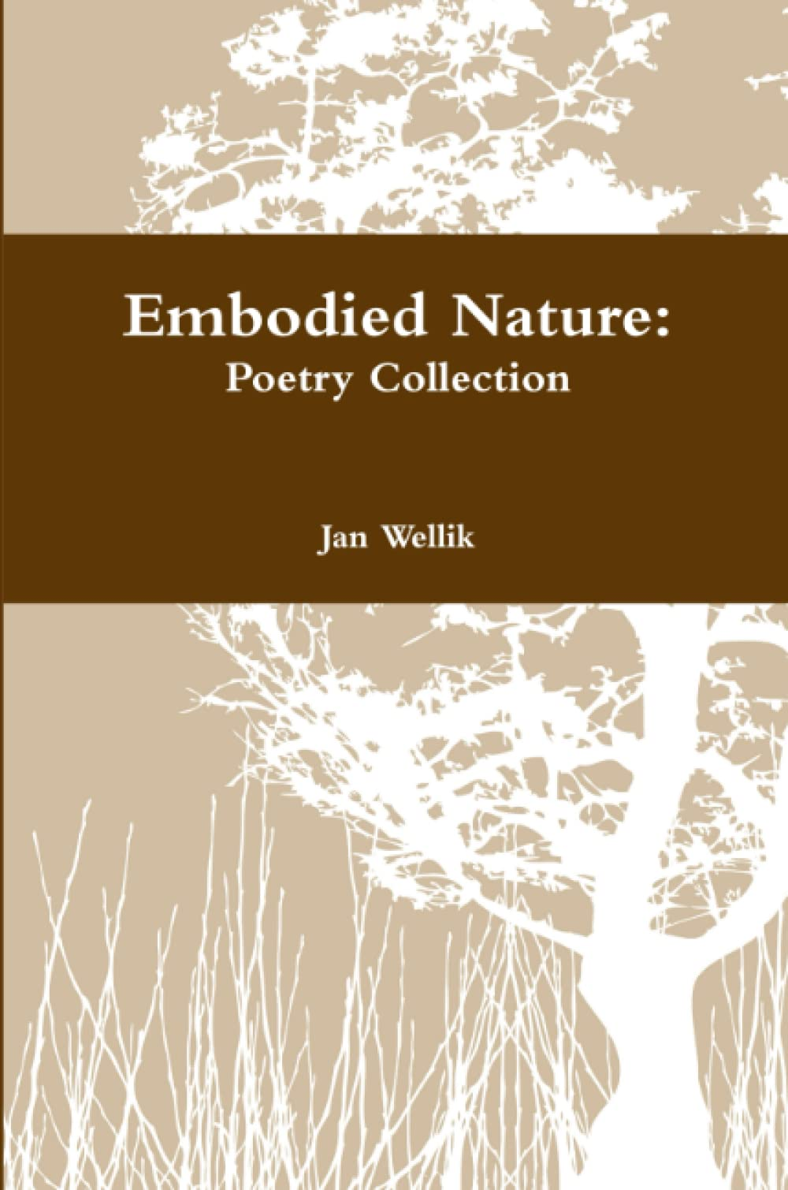
Nature Journaling
Eco Expressions originated in 2004 in San Diego, Calif. to combine the healing powers of nature and writing to inspire positive change.
Nature Writing Field Guide for Teachers by Jan Wellik, 2008
Embodied Nature: Poetry Collection by Jan Wellik, 2019

Slide 5
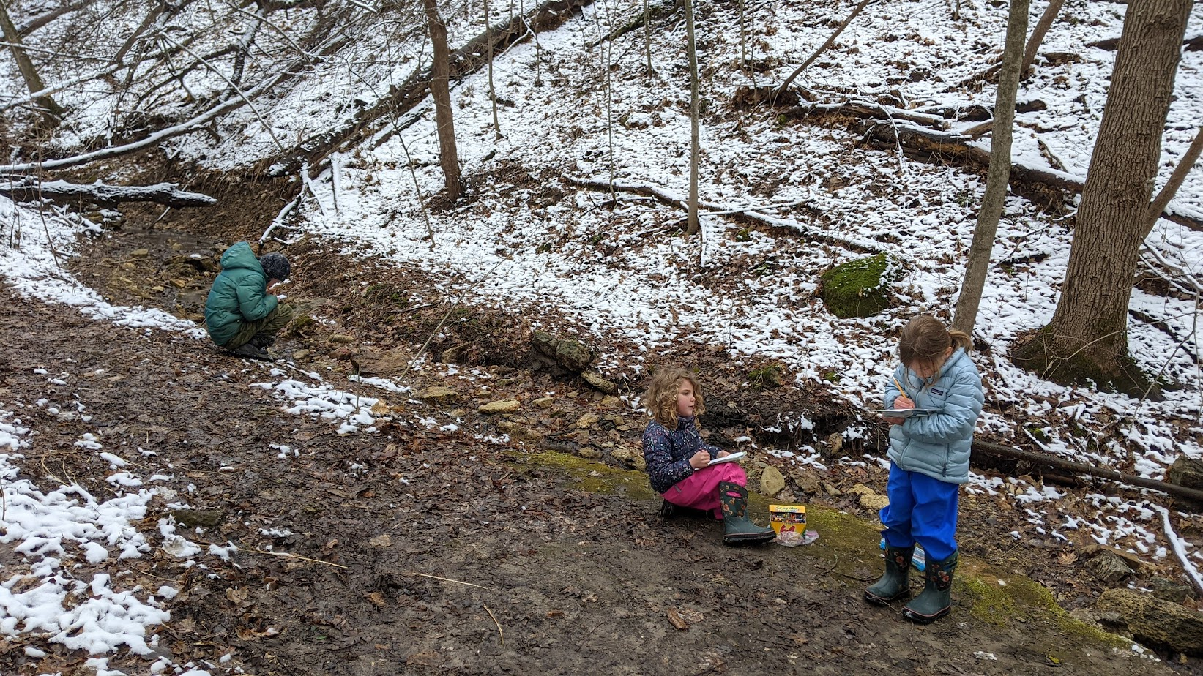
Nature Journaling with Kids
Wild Friday – Goose Island, Stoddard, WI
Wild Friday – Hass tract, Easter Rd. La Crosse, WI

Slide 6
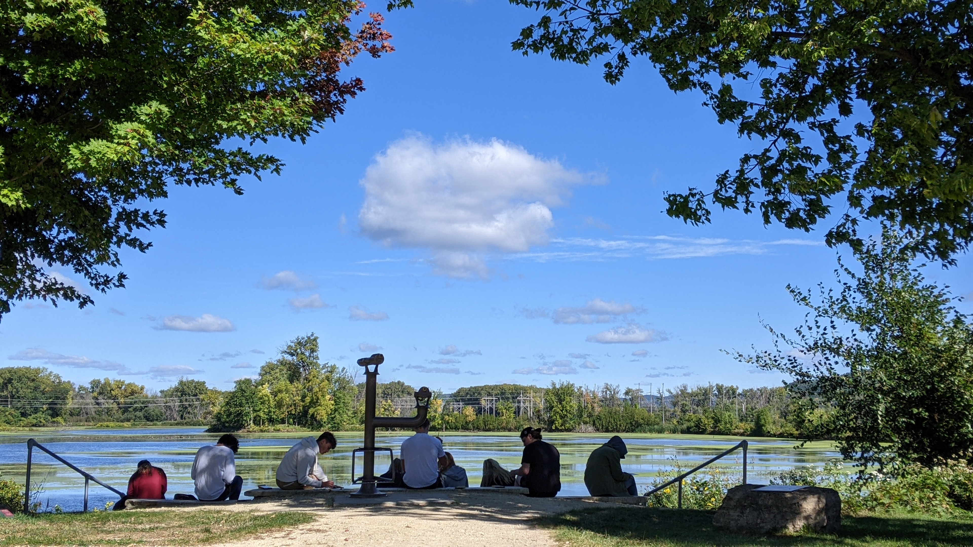
Nature Journaling with College Students
UW-La Crosse students – ENV 101

Slide 7
Wild Fridays: Nature & Art Every Season

Slide 8
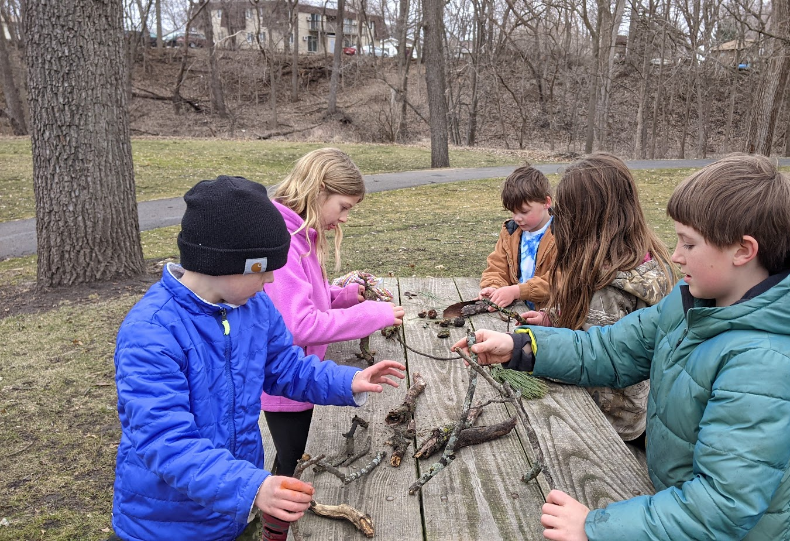
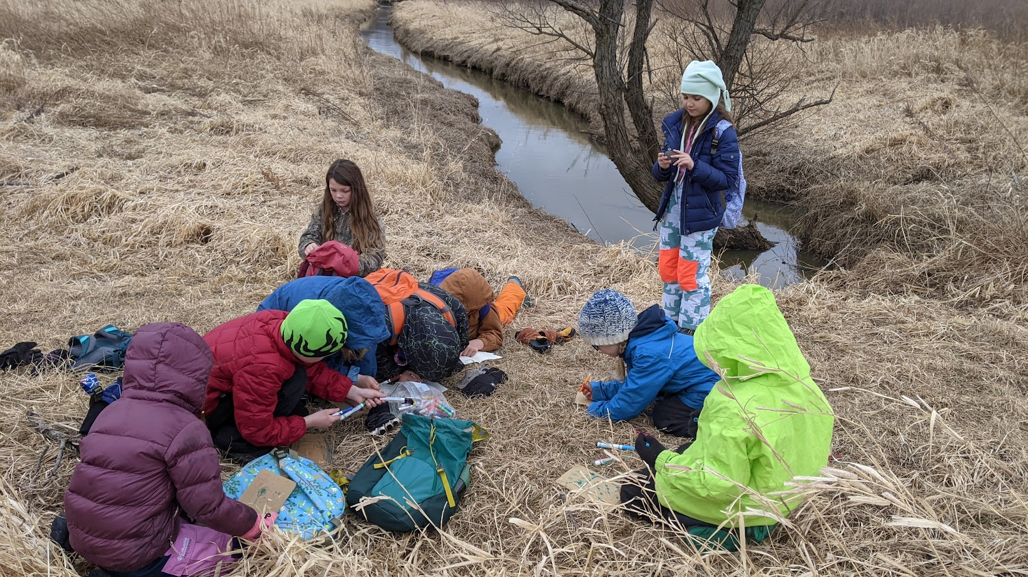
Nature Art Activities
Mindfulness Club – Halfway Creek Park, Holmen, WI
Wild Friday – La Crosse River Conservancy

Slide 9
Nature Journaling with John Muir Laws
Check out his videos for nature journaling techniques.
Let’s try Zoom In/ Zoom Out:
https://johnmuirlaws.com/njc-episode-4-zoom-in-zoom-out/

Slide 10
Nature Journaling Prompt
Nature Treasure:
Look around you, either inside or outside. Find a nature treasure: tree bark, seashell, rock, pinecone, flower, plant, feather, etc.
Observe your item using sight, touch or sound. Notice patterns, color, shape, and size.
Using pencil, sketch the image. Add colored pencils for shading and texture.
The goal is connection and awareness. Share with group.

Slide 11
Zoom Out Watercolor Painting
Go outside if possible, or find a window with a view of nature, or use a photo you have taken of a wild place that inspires you.
Zoom out on the whole landscape. Start by sketching with pencil an outline of the big picture: hills, flat land, waterways, etc.
Using watercolors paint your landscape from a distance, so it will not have the fine detail of the Zoom In.
Even if we are all looking at the same landscape, our paintings are usually different, based on our own perspective.
Share with group

Slide 12
Forest Bathing
Forest Bathing for Mindfulness & Health
F
“Forest bathing is not the same thing as hiking. The destination in forest bathing is ‘here,’ not ‘there.’ The pace is slow.
The focus is on connection and relationship” (Clifford 2).
Source: Your Guide to Forest Bathing by M. Amos Clifford
Sensory Experience: (Clifford p54-55)
Find a tree and engage your senses by touching the bark or a limb. Say or write “Outside I feel….; Inside I feel…”
Example: Outside I feel rough tree bark. Inside I feel safe in the woods.
You can explore other senses: sound, smell, touch, etc. or with different objects: rock, grass, dirt, sun, rabbit, bird, etc.

Slide 13
Nature Nurtures Healing
Nature Improves Mental, Physical & Emotional Health Articles
Nurtured by Nature – APA article, 2020: https://www.apa.org/monitor/2020/04/nurtured-nature
Effects of Nature on Mental & Physical Health, Mother Earth Living, 2020: https://www.motherearthliving.com/health-and-wellness/mind-and-body/nature-and-health-zmfz16mazolc/
Nature Impacts Our Wellbeing – UMN article: https://www.takingcharge.csh.umn.edu/how-does-nature-impact-our-wellbeing
Nature Therapy – Very Well Mind, 2022: https://www.verywellmind.com/how-nature-therapy-helps-your-mental-health-5210448
Nature & Mental Health – Science, 2019: https://www.science.org/doi/10.1126/sciadv.aax0903
Outdoor Health Benefits with Kids – NWF: https://www.nwf.org/home/kids-and-family/connecting-kids-and-nature/health-benefits-and-tips#:~:text=Children%27s%20stress%20levels%20fall%20within,for%20community%2C%20and%20close%20relationships

Slide 14
Nature Journaling Resources
Keeping a Nature Journal – book by Clare Walker Leslie
How to Teach Nature Journaling – book by John Muir Laws
The Nature Connection – book by Clare Walker Leslie
Journal Sparks – book by Emily Neuburger
Nature Journaling videos by John Muir Laws: https://johnmuirlaws.com/the-nature-journal-connection/

Slide 15
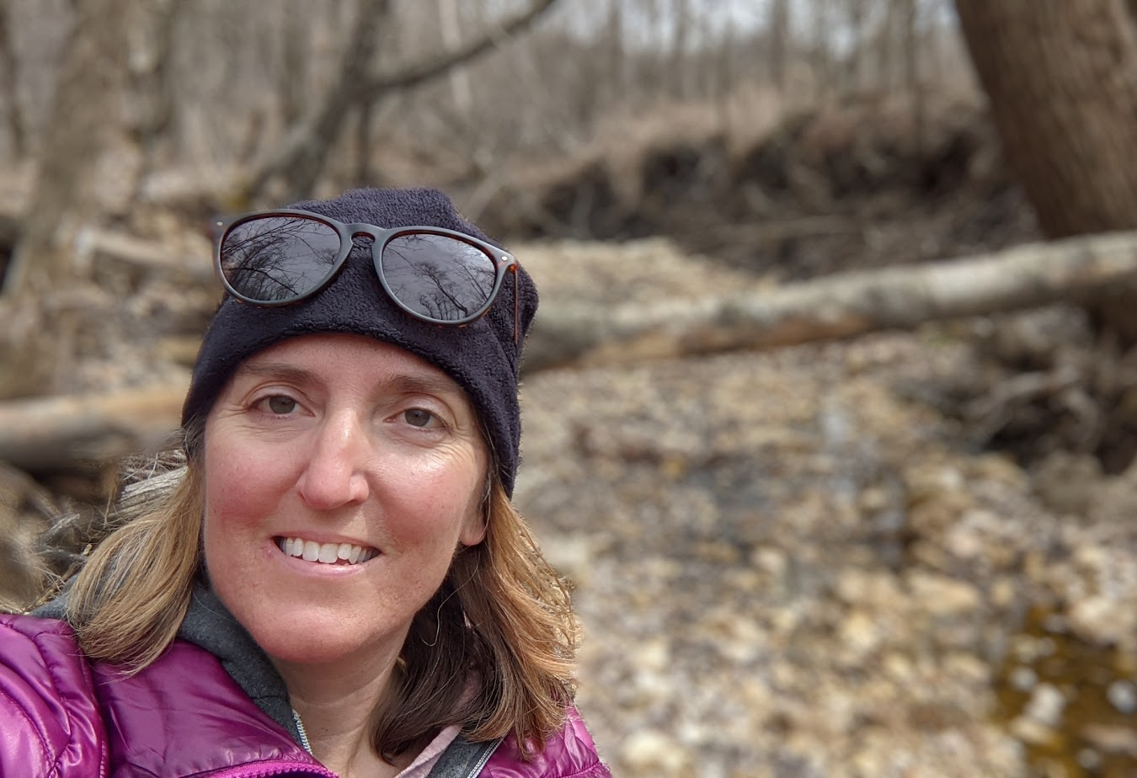
Thank you for being here!
How would you like to use nature journaling in your own life?
Dr. Jan Wellik, EdD​
natureartexpression@gmail.com
www.EcoExpressions.org

